Slide 1
Introduction
To this class

Slide 2

Class Info Part 1
As with all Friday electives, you don’t need to treat this class like a core class, and you are graded based on participation.
There is a discussion board on blackboard; you can use it to ask questions and share interesting things during the week.
All notes and whatnot will be on blackboard as well.

Slide 3

Class Info Part 2
During each class, I’ll usually lecture for 10-20 minutes or so, depending on the complexity of the topic.
Notes and information will be available on blackboard, including this intro presentation.
After we learn a new concept, some time will be spent experimenting, and doing programming exercises. During this time, feel free to look over the notes if you missed anything, and of course ask questions.
Based on the amount of time left, we’ll move on to another topic, and I will lecture again. You get the picture.
At the end of the class, we can discuss what everyone has been working on.

Slide 4

Class Info Part 3
The schedule (and more or less everything) is subject to change depending on how the semester plays out, but…
We’ll cover a wide variety of topics, so we will not be spending a ton of time on any one thing, unless desired.
There will be 2-3 projects where you can put to use what you’ve learned so far.
Next semester, there are several options of what we can do. We’ll discuss it towards the end of this semester.
Now, let’s jump right in!
Programming
Land

Slide 5
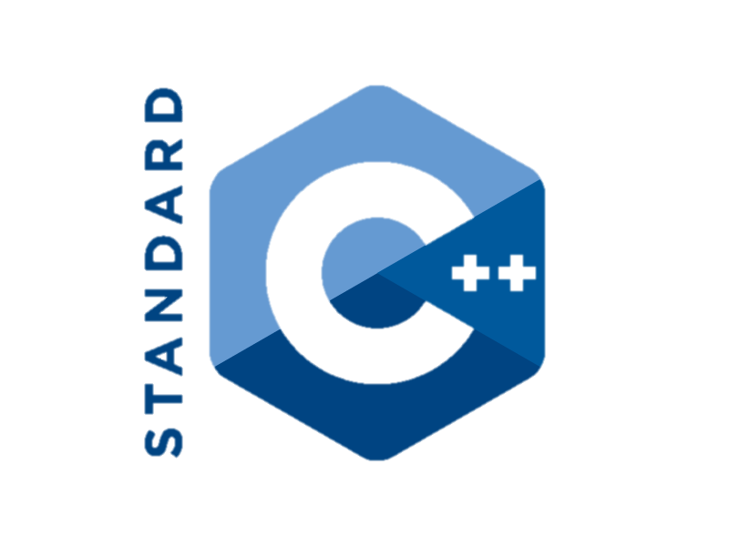
Why C++?
One of the most popular languages in the world, and is widely used in the software industry.
Easy to learn.
Powerful.
You wanted it.

Slide 6
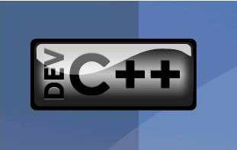
Coding in C++
There are many different compilers for C++, but for this class, we’ll be using Dev C++, which is an easy to use, lightweight IDE, or integrated development environment, that also includes a compiler. There are many other IDE’s, but Dev C++ is the best for now.
If you’d like to use Dev C++ on your own computer, there is a link on blackboard. Unfortunately, it only supports windows.

Slide 7



Using Dev C++ Part 1
Dev C++ is quite simple to use:
To create a new file, click on the new file icon in the top left, or press Ctrl+N.
To open a file, click on the open file icon next to the new file icon, or press Ctrl+O.
Save a file wherever you want with Ctrl+S.

Slide 8
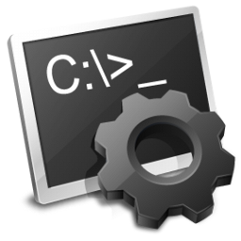

Using Dev C++ Part 2
Dev C++ is quite simple to use:
To compile your code, click on the Compile button, or press F9. This will create the .exe file that you can run.
To run your code, click on the Run button, or press F10. Note that your code must be compiled to run, and you must recompile the code when you make changes for the changes to take effect.
To compile and run your code with one action, click on the Compile & Run Button, or press F11. You get the idea.

Slide 9
Code in General Part 1
Programming is basically just writing instructions for a computer to make it do what you want. Your code is called the source code.
This code is then translated through the below process into a file that a computer can run.
Source Code
Executable
Program
Object Files
Compiler
Linker

Slide 10
Code in General Part 2
Then, when you run your program, your computer will simply go through your program, line by line, and execute the instructions you gave it.
Source Code
Executable
Program
Object Files
Compiler
Linker
Notes:
Since most of you have a little bit of experience with coding in general, I’ll just quickly go over the basics of programming: all of programming is just writing instructions to tell a computer what to do. There’s an old saying that explains this pretty well: “the computer does what you tell it do, not what you want it to.” But anyway, you write code, or these instructions, usually in an IDE (integrated development environment), which is an application in which you can write, compile, and debug code. Once you want to run your code, it is taken by your chosen language’s compiler and translated into an file that a computer can run, for example a .exe file. I’m not going to go into detail about different languages and compliers—that could be a class in of itself. In this class, we will be learning the language C++, for these reasons:

Slide 11
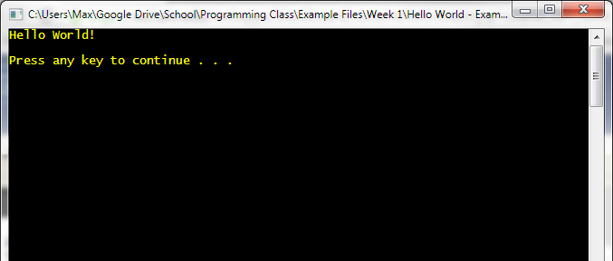
Hello World
“Hello World” is a simple program that one traditionally writes when trying a programming language for the first time. It also serves to make sure the development environment is working properly.
The program simply outputs “Hello World!” to the screen.
Notes:
DEMONSTRATE

Slide 12
Hello World
Now, you try it! Dev C++ should already be installed on your computers.
If you have questions, ask.
Note: from here on, I won’t be making presentations; I’ll just explain the topics and provide notes.

